Slide 1
2026 World Cup Schedule & Ticket Revenue Optimization
GENBUS 730 - Final Project
University of Wisconsin, School of Business
Xiao (Freeman) Zhang, MSBA 23’ Candidate

Slide 2

Fifa World Cup & 2026 US | Canada | Mexico
The biggest and most famous sports event in the world. It’s soccer (or football)!!
Teams from countries on five continents, a sports party for people all over the world
The 2022 Qatar World Cup, which is currently in full swing, has reached the semi-finals, and this will undoubtedly remind people of the next World Cup in 2026.
It’s the first world cup in North America and it’s first time that the world cup will have 48 teams!

Slide 3
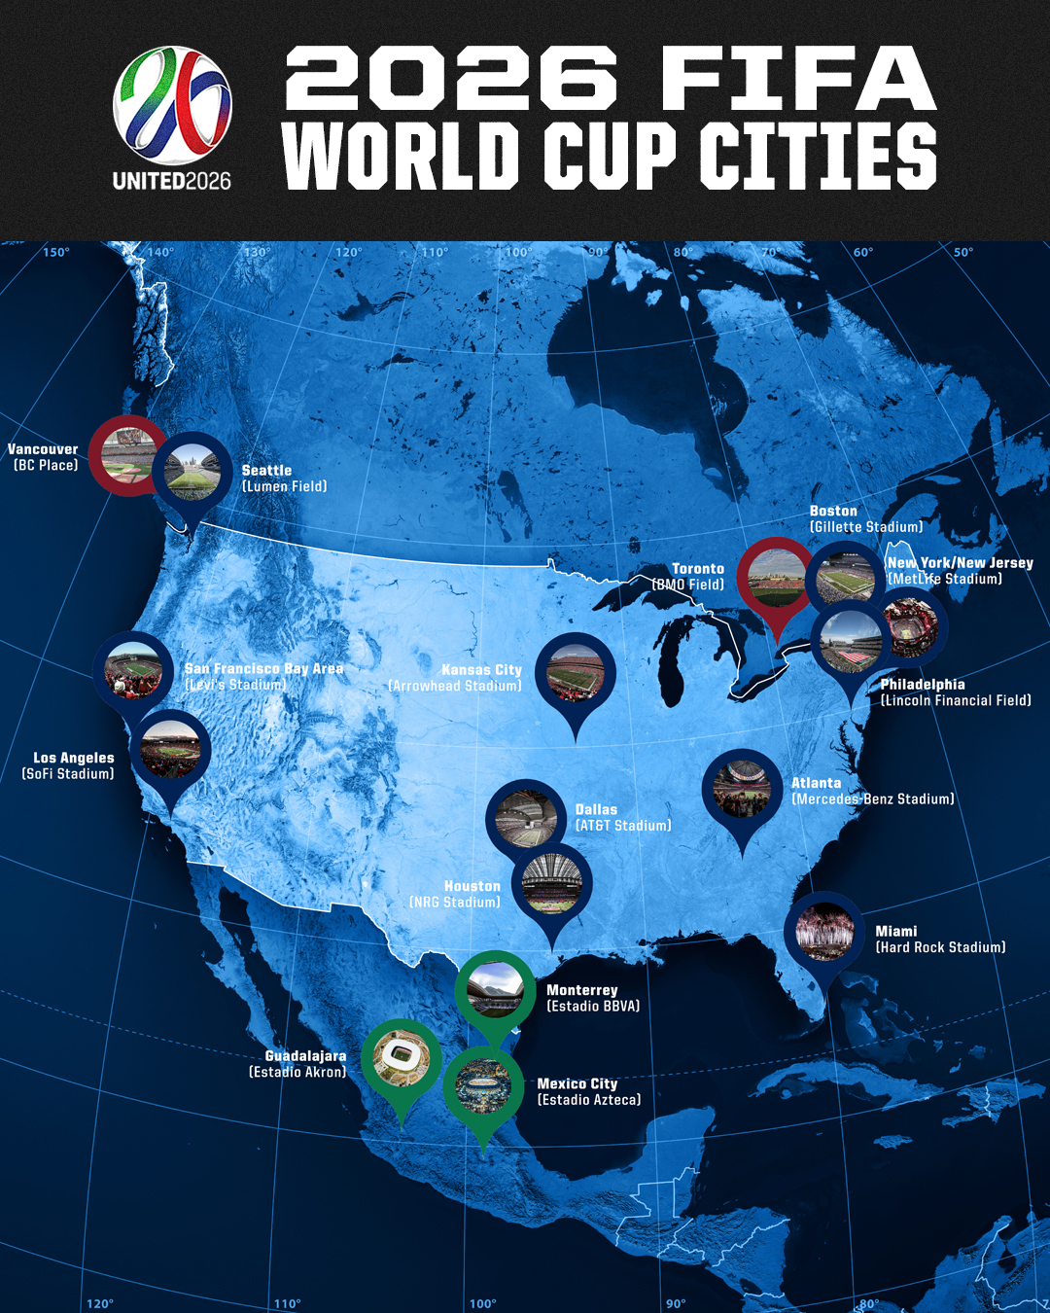
2026 World Cup Schedule & Ticket Revenue
The 2022 Qatar World cup is the last World Cup that has 32 teams and 64 games.
For the first time in forever, the world cup will have 48 teams and 80 games in 2026.
Nobody knows how 80 games will be scheduled in 32 days and how to distribute the 16 stadiums.
The Fifa and the 2026 World cup committee also want to maximize ticket revenue.
An optimization model for potential game schedules and maximizing ticket revenue is essential and helpful!!

Slide 4

An MILP Optimization Program
Objective: Maximize the Ticker revenue
Through my research, I already have an estimated average ticket price for all 80 games based on the ticket price of the 2022 World Cup; the 16 stadiums’ capacity.
We want to use these data to maximize ticket revenue while have an complete schedule. For the total revenue, we multiply the capacity with ticket price of every game the stadium will hold, then sum all the stadiums’ revenue.
Decision variables: An 16(Stadium)*80(Game) binary table
For each one little box of the 1,280 table, 1 means the game will be held on this stadium, 0 means the game will not be held on this stadium.
Constraints: A lot
Each game can only been held in one stadium and 80 games in total.
Each stadium in Canada should have at least 5 games; each stadium in Mexico should have at least 3 games and Estadio Azteca should have at least 4; and each stadium in the US should have at least 4 games.
For Excel example, we only show a schedule in the first two days
Each country should have a game in the opening day with total 3 games in the opening day.
Each stadium cannot hold more than 1 game in the first two days.

Slide 5


Optimization Program: Excel & Python
In this World Cup optimization Problem, we use both Excel and Python.
Excel is used to solve an example: partial but more specific schedule & revenue problem.
The World Cup opening day and second day.
Different and more specific constraints.
Python is used to solve the whole schedule & revenue optimization problem.
A 16*80 = 1280 table of decision variables is impossible to be solved by Excel Solver.
Upload the World Cup stadium and game ticket data, then use the Python Pymol function to solve the optimization problem.
The result will be a complete world cup schedule with the maximum ticket revenue.

Slide 6
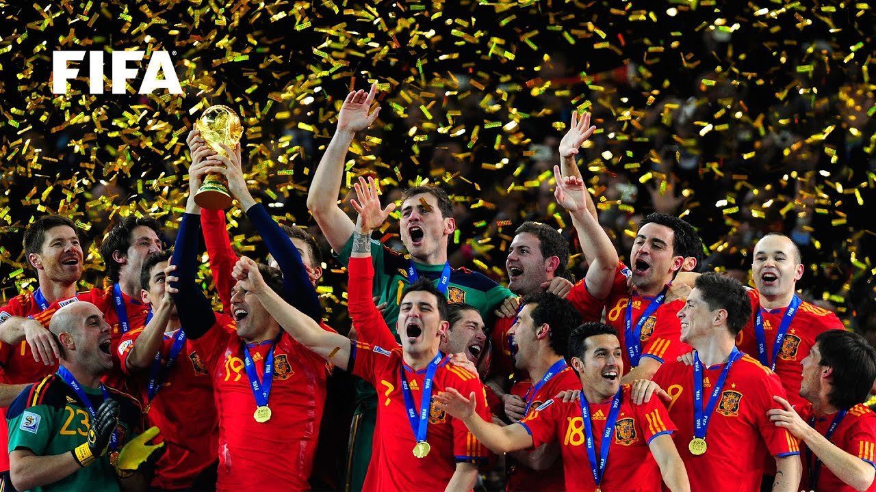
Key Assumptions & Challenges
Biggest Assumption: the 2026 World Cup Setting
Again, it’s first time that the world cup has 48 teams and 80 games, we need to assume that yes, we have 48 teams and 80 games and there is no big structure change.
We made an example trial in Excel and we assume that the opening day has three games in three countries and the second day has four games.
Second Biggest Assumption: The ticket price
Still have four years and no one know the ticket price right now, so we can only assume that the average ticket price for each game is similar to 2022 Qatar World cup.
Also, again, 80 games for the first time, so we need to assume an new ticket price level system.
Challenge: Data research
Stadium information
Ticker price References
2026 World Cup Overall information & Setting
Challenge of presenting: Schedule present & MILP Optimization
How should I show the game and stadium?
How can I make the program more organized?

Slide 7
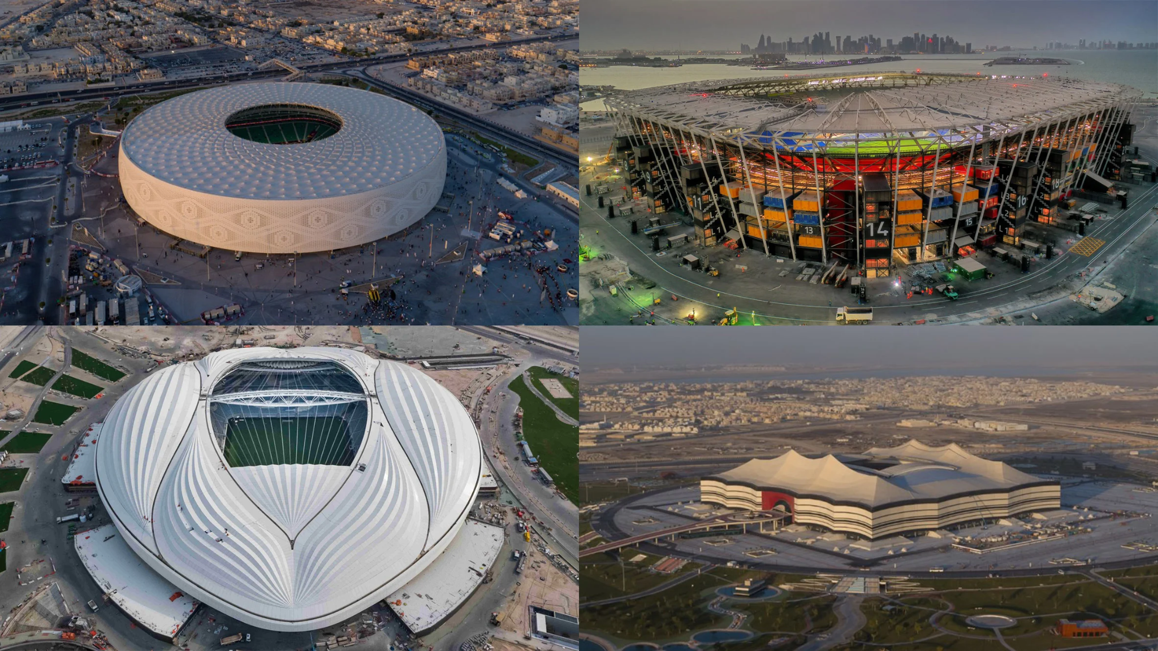
How impressive the project is? (!)
Excel optimization gives an accurate answer that which stadium will hold which game in the first two days. Also, we can see how much ticket revenue will each stadium have and in total.
Python optimization gives an basic model to create a schedule with some very basic constraints, and games are equally assigned on 16 stadium according to the potential distribution.
For both excel and python, it’s easy to add, delete or edit constraint if there are more stadium setting to rules. For example, each stadium cannot hold two games in a row or games in the same group cannot be held in the same stadium. We can update the model when more rules be published.

Slide 8
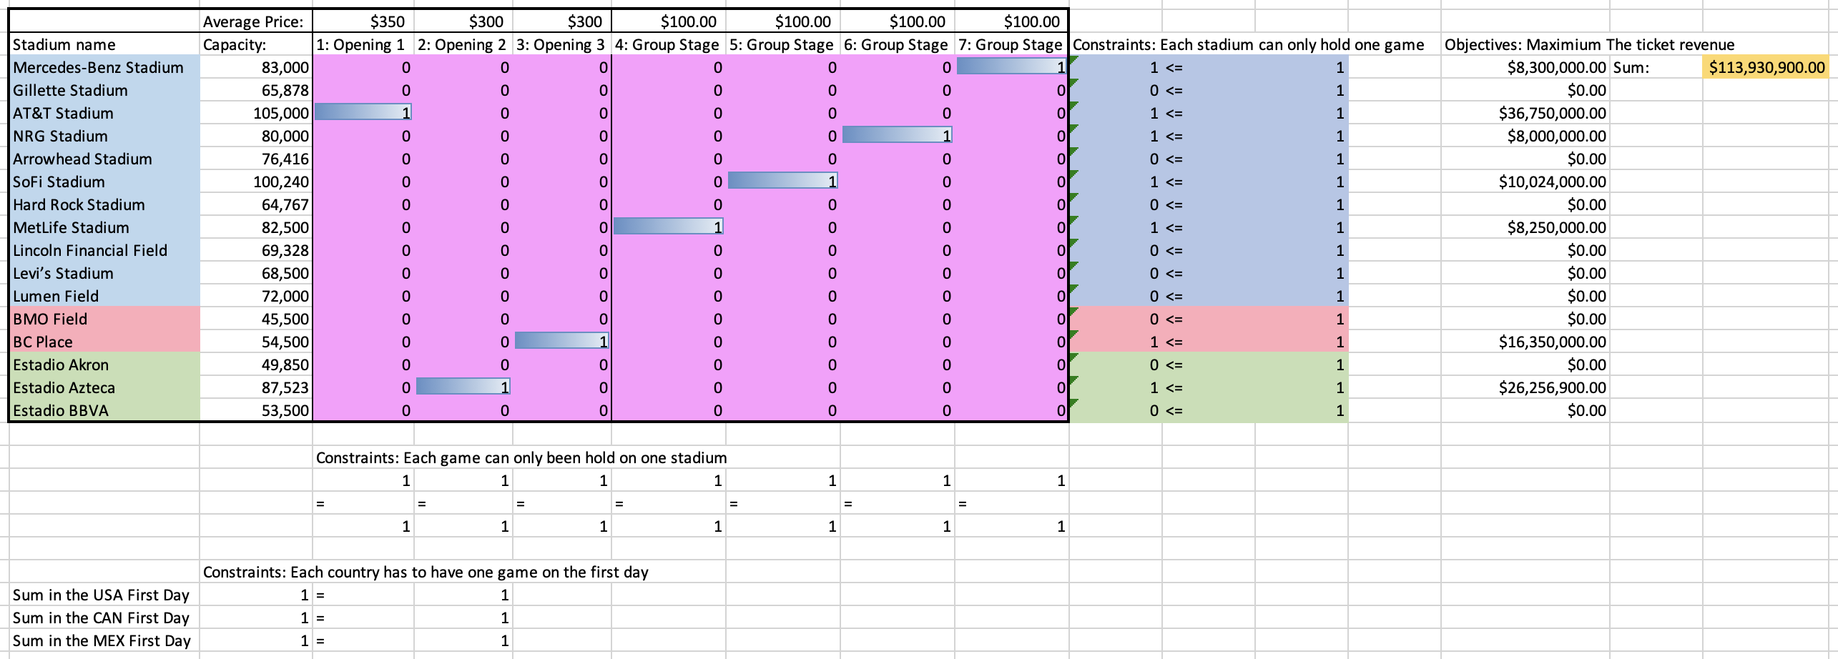
Excel Optimization Example

Slide 9
Excel Optimization Example Explanation
It’s an example optimization model for the first two days schedule. We assume there will be three games for each host country’s team in the opening day and four group stage games in the second day.
We can find the stadiums’ name and capacity in the first column and the game’s name in the first row. All the blue stadium stand for the stadium in the US; red stadiums are in Canada and green stadium in Mexico. Also, we have the ticket price for every game.
All the pink boxes are the decision variables, and we colored all the result 1 with blue. If you find a 1, that means the game in the corresponding column will be played in the corresponding stadium row.
We set the constraints of each game has to be played once in only one stadium, and in the opening day, each host country has to play one game.
We will have a ticket revenue of every game if we use the ticket price to multiply the corresponding stadium’s capacity. Then we sum all the game’s ticket revenue and it shows in the orange box.
We use the Excel Solver to find the game host plan with the maximum ticket revenue.

Slide 10
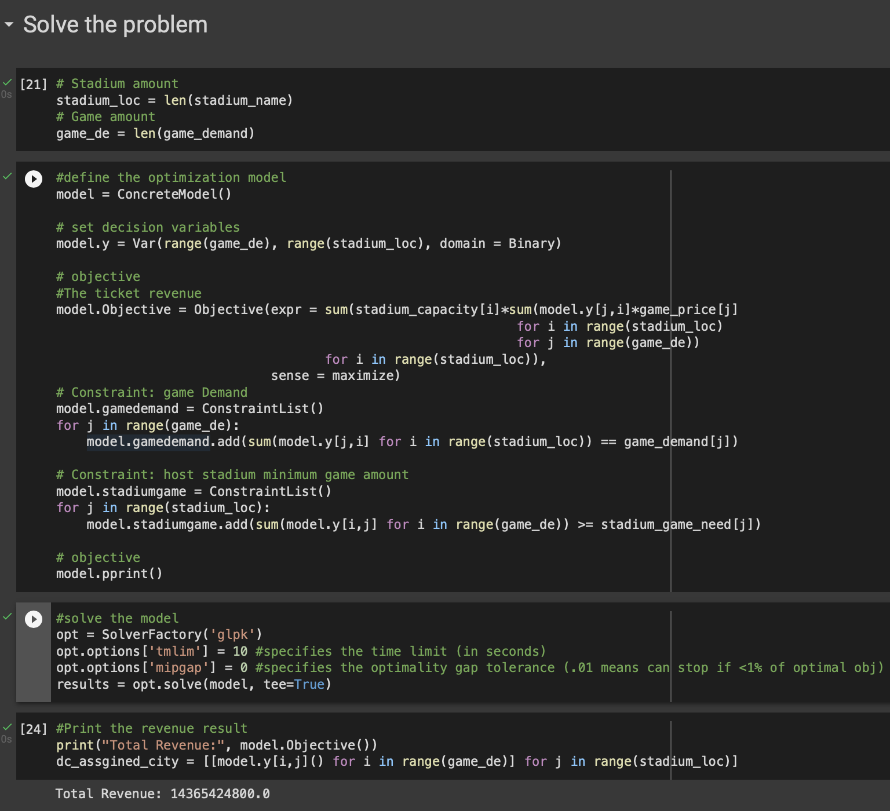
Overall Python Optimization Explanation
In python, we try to solve the overall schedule problem for all the 80 games, however, we has less constraints due to the Insufficient technology and unknown schedule setting.
So far, we only have the constraints of all the 80 games has to be held once in only one stadium and the minimum amount of games to be held for each stadium.
We already prepare a basic World cup dataset and upload it to Google Colab. The App will run the code to transform the data set to different list, and Pymol function. Then it will print an objective ticket revenue and generate a bigger data table of whole 80 games just similar as the Excel example.

Slide 11
Excel: Projected Benefits & How to use?
Excel: How to use?
In the excel model, user can change the game name, price, stadium and capacity. Also, user can add more constraints of stadium use or host countries.
User can re-fill the days and name of the games, for example, this model can have generate a whole schedule for all the round of 16 games.
Setting the selected games and days, and re-edit the constraints, user re-run the solver and will get a short-term schedule with the max revenue.
Excel: Benefits
User can easily generate a few-days’ schedule with the max revenue in the excel model. For example, round of 16 or round of 8.
Users can adjust the schedule within a short period of time as needed when the general schedule is determined.
If there is any change of the basic game setting or the stadium using, just update on the file and it will immediately give you a new schedule.
It’s a model that can generate a revenue but doesn’t have to be maximum. User can adjust their target revenue like no more than or higher than some amount.

Slide 12
Python: Projected Benefits & How to use?
Python: How to use?
For python program, user need to use it by combining with the dataset, because the data need to upload to the program first.
In dataset, user can update all the information such as stadium information or ticket prices.
After python transfer the dataset to list, we can start to use it!
The python only provide a model with basic constraint. It there any schedule rules or stadium restrictions with the World Cup approaching, user can add more constraints.
User run everything and the program will generate a whole 80 games schedule with the max ticket revenue!
Python: Benefits
Similar with excel, python program can save plenty of time to generate a schedule. User just need to upload the updated dataset and python will finish the work.
User can adjust the constraints and information easily as they want. It’s still four years and there are lots of uncertainties. User can edit and add constraints, as well as the World Cup information in the dataset as the time coming.
The result is very clear. The python will generate a data frame that shows all the 80 games schedule.
Again, the objective is the ticket revenue, but it doesn’t have to be max, it can be minimum or 80% level. Also, the objective could be no more than or just more than some revenue amount.

Slide 13

Limitation & Improvement
Limitation:
So far, this model can only consider about the stadium capacity, price, and game. However, as a huge sports events, there are lots of consideration on schedule like sponsorship, advertisement, city arrangement. This model does not consider these features.
Some basic constraints did not show on the python program. Such as how often stadiums are utilized, or which games a particular stadium must host.
The constraint of host country. So far, the program cannot reasonably distribute the game of the three host countries. In theory, we hope that the 16 venues in the three countries will distribute important games reasonably.
Improvement:
In the python model, If I have more time and information updates, I also need to increase the limit on the frequency and span of games in a single venue. For example, I don't want to have stadium that will host consecutive games or all group stage matches or important round matches.
For both Excel and Python, I would also like adjust the presentation of the results, for example converting the existing results into a full time list for easier understanding by the user.
If I have time, I would also like to build ancillary models of sponsorships, advertising and other potential influences on the schedule, which would make the whole model more realistic and complete.

Slide 14
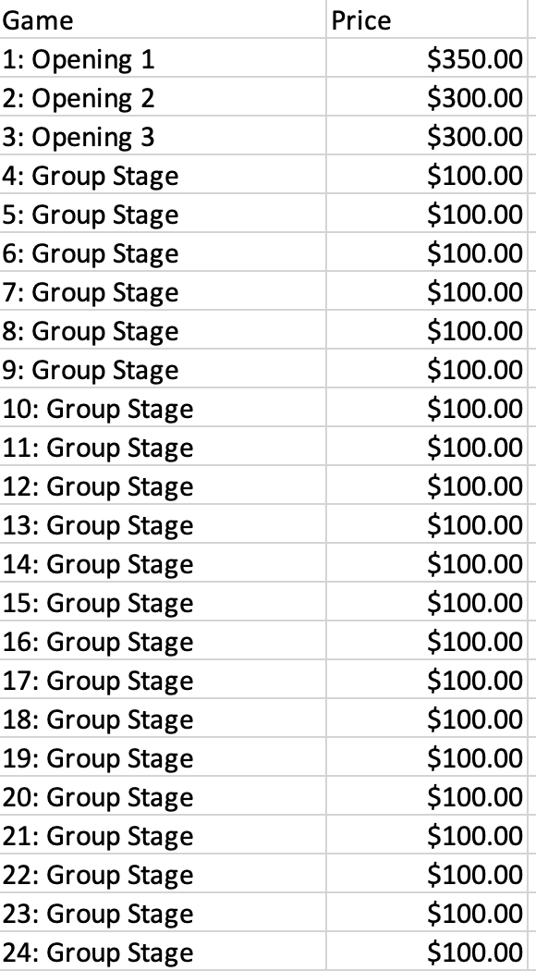
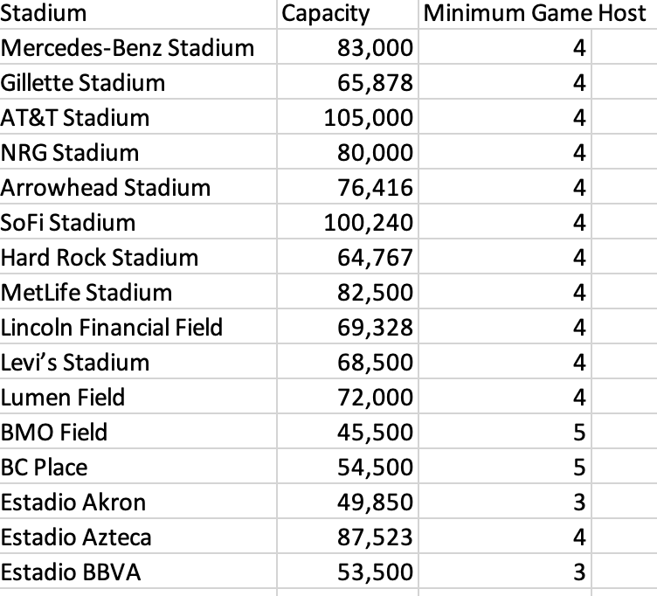
Supporting Files
The research information and the Excel Dataset.
All the research information resources will be put in the references page.
As we mentioned before, the python need to used with the dataset with lots of information, and that is the most important supporting files for the optimization program.
As we can see from the right, there are two example of the dataset which are the stadium information with capacity and least game need to host. Also, we have the game information with it estimated price.

Slide 15
References:
https://soccer.nbcsports.com/2022/12/15/2026-world-cup-venues-which-cities-will-host-in-usa-canada-mexico/
https://www.sportingnews.com/us/soccer/news/world-cup-2026-host-cities-fifa-stadium-usa-canada-mexico/unapmka5z2tmlcz0rkrrau5q
https://www.fifa.com/fifaplus/en/articles/ticket-prices-en
https://digitalhub.fifa.com/m/7aefe2d8cee025b2/original/FWC-2022-Match-Schedule-281122.pdf
https://bleacherreport.com/articles/2776110-world-cup-schedule-2018-full-fixtures-and-kick-off-times-for-every-match
https://www.theguardian.com/football/2018/jun/13/three-hosts-48-teams-how-the-2026-world-cup-will-work-united

